Slide 1
Designing a Data Model with Power BI Desktop
Notes:
This module dives deep into the data modeling features available when using Power BI Desktop project and Data Analysis Expression language (DAX). Students will learn about the technical details of table relationships as well as the basic syntax required to write maintainable DAX expressions. The module demonstrates how to create calculated columns and measures and then explains when to use one versus the other. The module teaches students how to import a lookup table from a secondary data source and integrate it into the data model to assist with data categorization. The module concludes by demonstrating how to configure the metadata for geolocation fields within a data model so they can be used to visually map aggregated data values to geographical locations such as countries, states, cities and zipcodes.

Slide 2
Agenda
Modeling Data in Power BI Desktop
Understanding Table Relationships
Writing DAX Expressions
Creating Calculated Columns
Creating Measures to Aggregate Data
Adding Geographic Fields to a Data Model

Slide 3
Data Modeling with Power BI Desktop
Steps to create a data model with Power Pivot
Create relationships between tables
Modify columns (rename, set formatting, convert type)
Create calculated columns
Create measures
Add column metadata
Create dimensional hierarchies
Add Calendar table(s)
Covered in next module

Slide 4
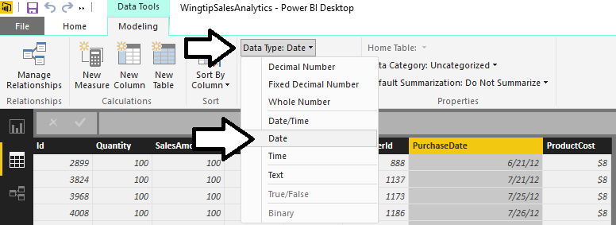
Converting Column Types
Power Pivot allows you to convert columns
Alternative to converting column with Power Query

Slide 5
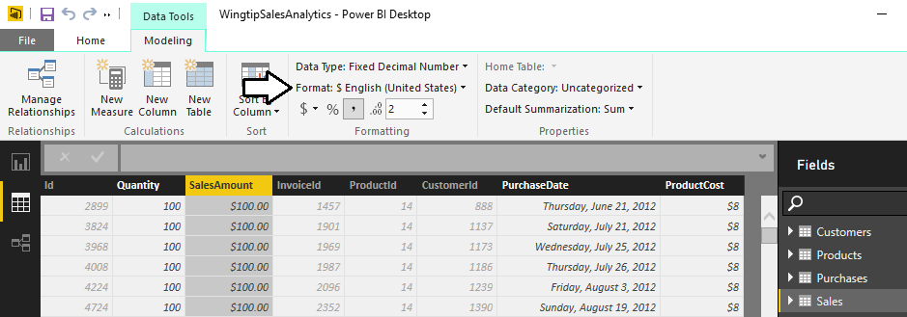
Formatting Columns
Each column has its own formatting properties
Formatting propagated to reports and visuals
Makes it easier on data model consumers

Slide 6
Agenda
Modeling Data in Power BI Desktop
Understanding Table Relationships
Writing DAX Expressions
Creating Calculated Columns
Creating Measures to Aggregate Data
Adding Geographic Fields to a Data Model

Slide 7
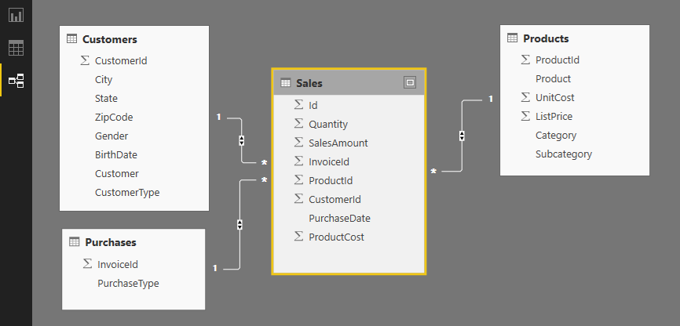
Table Relationships
Tables in data model associated with relationships
Relationships based on single columns
Tabular model supports [1-to-1] and [1-to-many] relationships
Relationships based on single column in each table

Slide 8
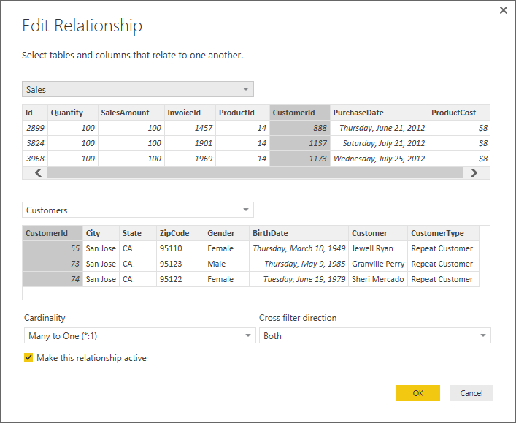
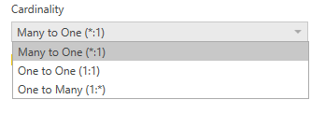

Relationship Properties
Cardinality
Cross filter direction

Slide 9
Agenda
Modeling Data in Power BI Desktop
Understanding Table Relationships
Writing DAX Expressions
Creating Calculated Columns
Creating Measures to Aggregate Data
Adding Geographic Fields to a Data Model

Slide 10
Working with DAX
DAX is the language used to create data model
DAX stands for "Data Analysis Expression Language"
DAX expressions are similar to Excel formulas
They always start with an equal sign (=)
DAX provides many built-in functions similar to Excel
DAX Expressions are unlike Excel formulas…
DAX expressions cannot reference cells (e.g. A1 or C4)
Instead DAX expressions reference columns and tables
=SUM('Sales'[SalesAmount])

Slide 11
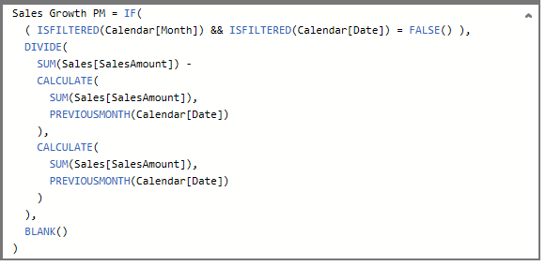
Writing DAX Expressions
Some DAX expressions are simple
Some DAX expressions are far more complex

Slide 12
Types of DAX Functions
Date and Time Functions
Information Functions
Logical Functions
Mathematical and Trigonometric Functions
Statistical Functions
Filter Functions
Text Functions
Time Intelligence Functions

Slide 13
Calculated Columns vs Measures
Calculated Columns (aka Columns)
Evaluated based on context of a single row
Evaluated when data is loaded into memory
Measures
Evaluated at query time based on current filter context
Commonly used for aggregations (e.g. SUM, AVG, etc.)
Used more frequently than calculated columns
Column1 = <DAX expression>
Measure1 = <DAX expression>

Slide 14
Agenda
Modeling Data in Power BI Desktop
Understanding Table Relationships
Writing DAX Expressions
Creating Calculated Columns
Creating Measures to Aggregate Data
Adding Geographic Fields to a Data Model

Slide 15
When to Create Calculated Columns
Measures often better choice than calculate columns
Don't create calculated column when you need a measure
Prefer to create calculated columns only in specific scenarios
When should you create calculated columns?
To create headers for row labels or column labels
To place calculated results in a slicer for filtering
Define an expression strictly bound to current row
Categories text or numbers (e.g. customer age groups)

Slide 16
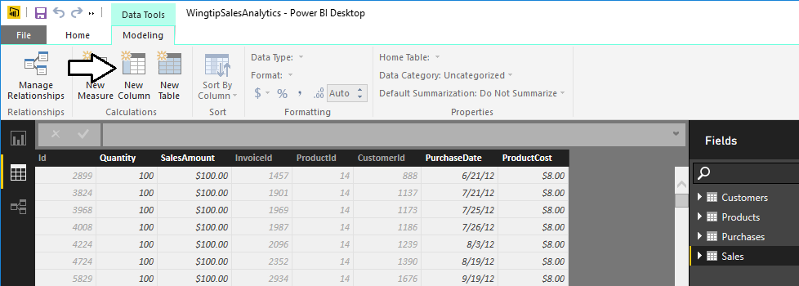
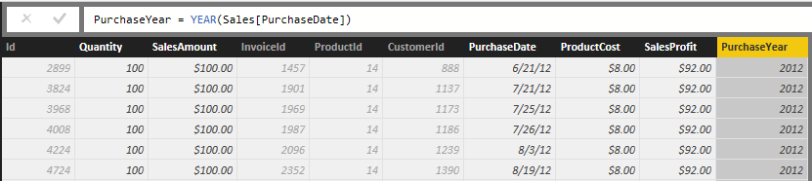
Creating Calculated Columns
Edited in formula bar of Power Pivot data view
Start with name and then equals (=) sign
Enter a valid DAX expression
Clicking on column adds it into expression

Slide 17
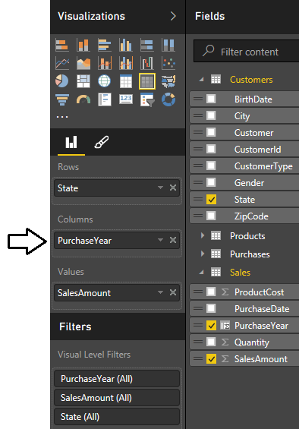
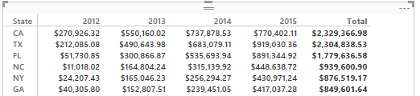
Calculated Column as a Column Label
Calculate column can serve as...
Row labels
Column labels

Slide 18
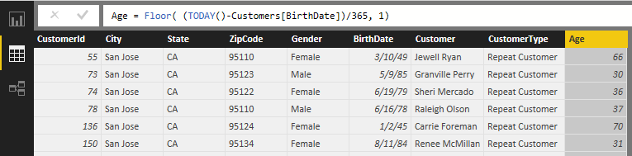
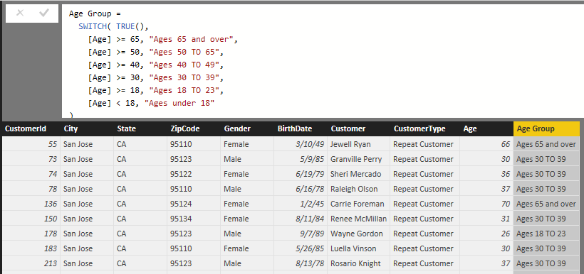
Calculated Column for Customer Age Group
Calculate customer age from birthdate
Calculate age groups using calculated column

Slide 19
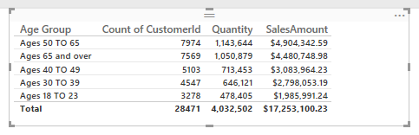
Calculated Column as a Row Label
Age Group can now be used as row label

Slide 20
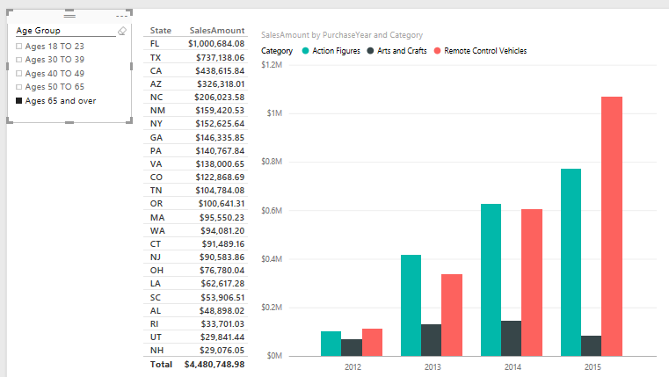
Calculated Column used in a Slicer
Calculated column can populate slicer values

Slide 21
Creating Calculated Columns

Slide 22
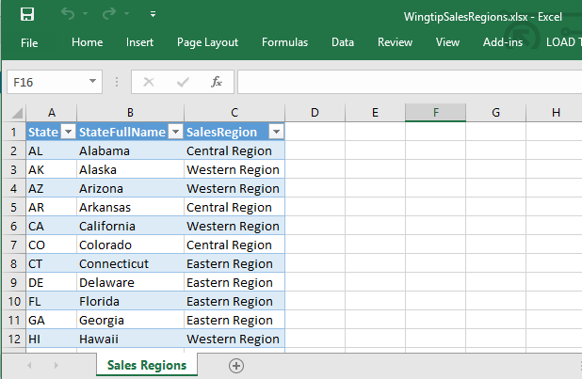
Adding Lookup Tables to the Data Model
Data modeling might required adding lookup tables
Lookup tables inject extra related data into data model
Example: Sales Regions table
Assign each state to specific sales region
Include full state name it required in reporting

Slide 23
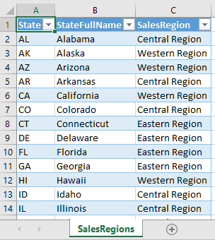
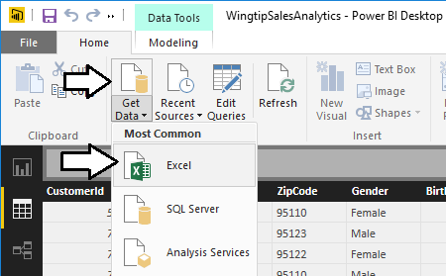
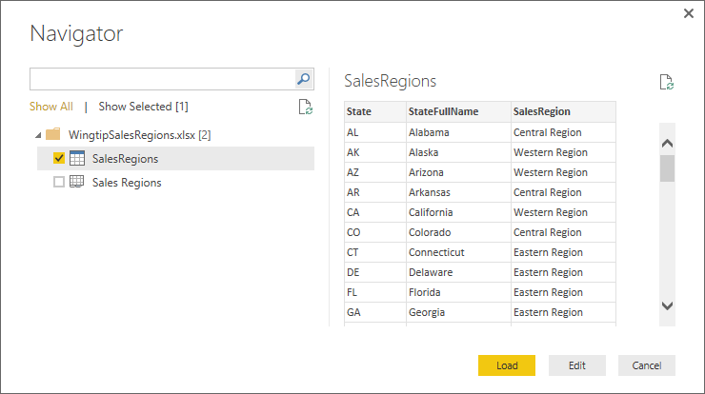
Importing the SalesRegions Table from Excel
Import table from Excel using Power Query
1
2
3

Slide 24
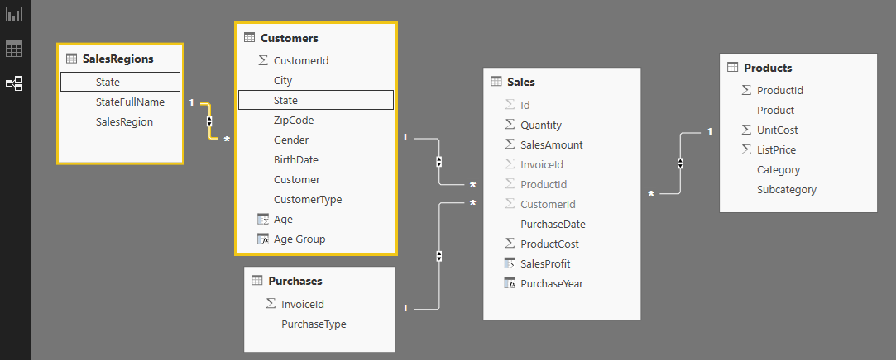
Integrating the Lookup Table into the Data Model
Lookup table must be integrated into data model
Accomplished by creating relationship to one or more tables

Slide 25
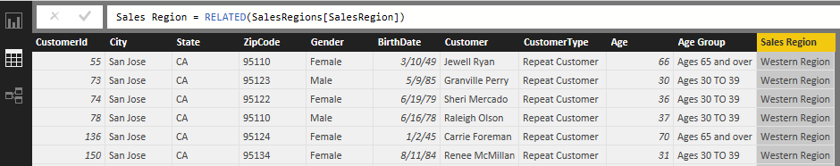
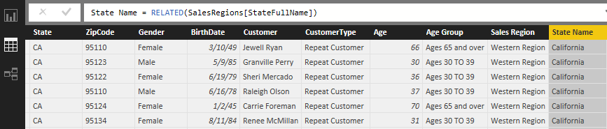
The RELATED Function
RELATED function performs cross-table lookup
Effectively replaces older VLOOKUP function
Used in many-side table to look up value from one-side
Used to pull data from lookup table into primary table

Slide 26
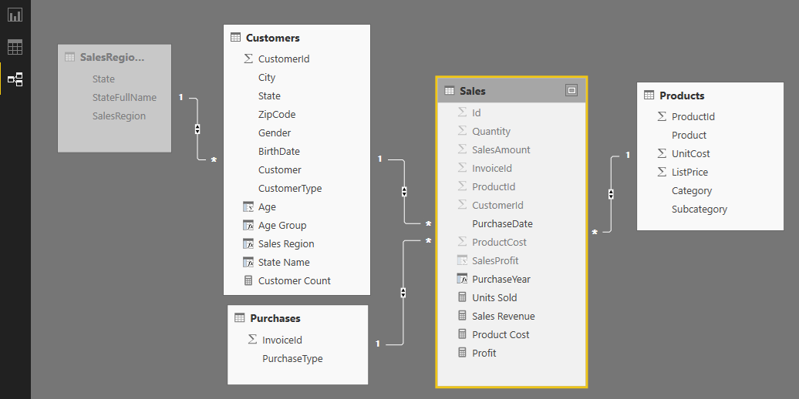
Hiding the Lookup Table
Lookup table can often be hidden
simplifies reporting for data model consumers

Slide 27
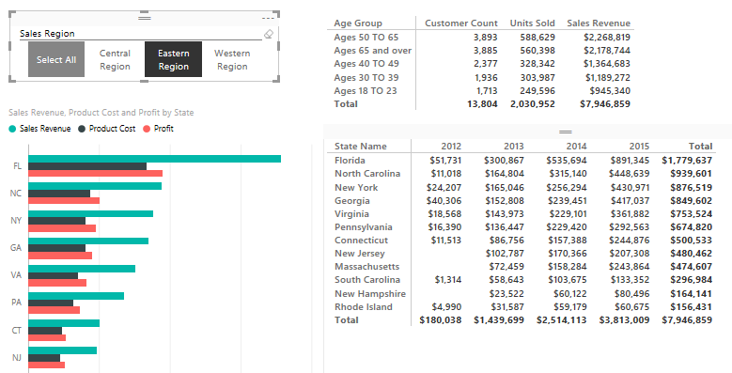
Filtering on Sales Region
Calculated column used to calculate slicer values

Slide 28
Agenda
Modeling Data in Power BI Desktop
Understanding Table Relationships
Writing DAX Expressions
Creating Calculated Columns
Creating Measures to Aggregate Data
Adding Geographic Fields to a Data Model

Slide 29
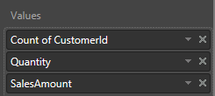
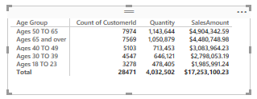
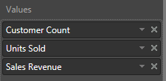
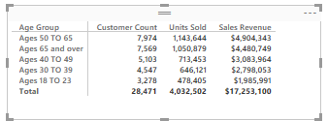
Benefits of Measures over Calculated Columns
Calculated columns can be aggregated in visual
However, aggregation details are stored in visual
Visual doesn't offer control over name and formatting
Measure defines name, aggregation and formatting
Work is done once and reused across many visuals
Makes data model more fool-proof for report designers

Slide 30
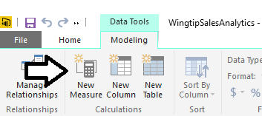
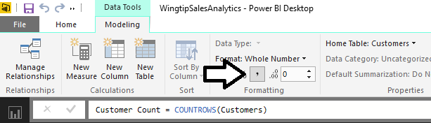
Creating Measures
Measures have advantage over calculated columns
They are evaluated based on the current evaluation context
Creating a measure with Power BI Desktop
Click New Measure button
Give measure a name and write DAX expressions
Configure formatting
1
3
2

Slide 31
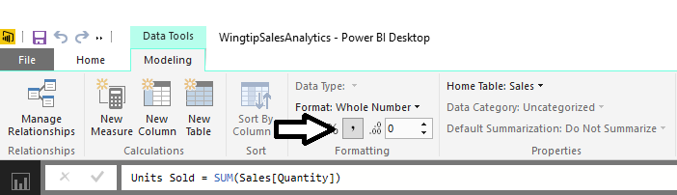
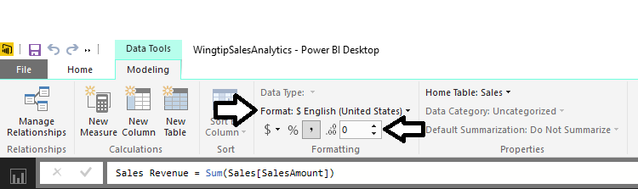
Formatting Measures
Format as whole number
Format as currency

Slide 32
Creating Measures

Slide 33
Agenda
Modeling Data in Power BI Desktop
Understanding Table Relationships
Writing DAX Expressions
Creating Calculated Columns
Creating Measures to Aggregate Data
Adding Geographic Fields to a Data Model

Slide 34
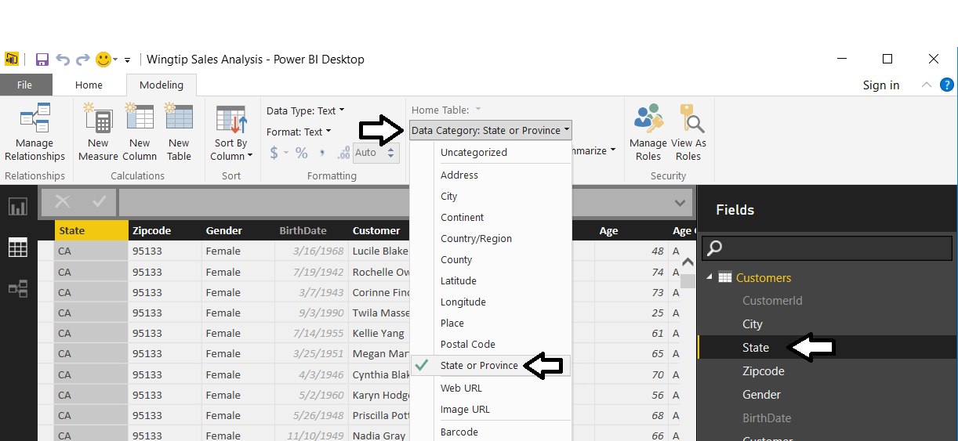
Geographic Field Metadata
Fields in data model have metadata properties
Metadata used by visuals and reporting tools
Used as hints to Bing Mapping service

Slide 35
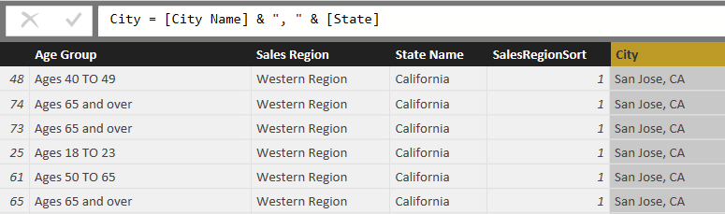
Eliminate Geographic Ambiguity
City name alone is ambiguous
"Athens" defaults to Greece not Georgia
Concatenate city name with state to disambiguate

Slide 36
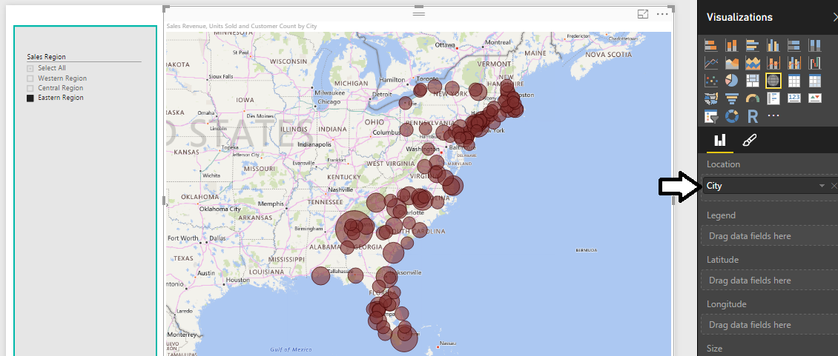
Using Map Visual with a Geographic Field
Map Visual shows distribution over geographic area
Visual automatically updates when filtered

Slide 37
Summary
Modeling Data in Power BI Desktop
Understanding Table Relationships
Writing DAX Expressions
Creating Calculated Columns
Creating Measures to Aggregate Data
Adding Geographic Fields to a Data Model

